Slide 1
Object-Oriented Programming
WEEK 01 Abeeha Sattar

Slide 2
Let’s Introduce Ourselves
Name: Abeeha Sattar
Qualifications: MS(CS) from IBA (2020), BS(CS) from FAST-NUCES (2016)
Experience: Worked in Systems Ltd. for about 1.5 years.
Courses Taught: IPT, SDA, SCD, OOP-Theory & Lab

Slide 3
Consultation Hours
You can visit me on Tuesdays or Wednesdays.
Faculty Offices opposite to CS Secretariat, Room # 8
Do email me before visiting!
Email: abeeha.sattar@nu.edu.pk

Slide 4
Pre- Requisites for the Course
How to think a program.
How to write a program.
Basic Programming structure.

Slide 5
Assignments & Quizzes
There will be 3 assignments and 3 quizzes.
Quiz Schedule (tentative):
Q1 – 3rd Week
Q2 – 7th Week
Q3 – 10th Week
Q4 – 13th/14th Week

Slide 6
Grading Scheme
Programming Assignments 8 %
Quizzes 12 %
Midterms (2) 30 %
Final 50 %

Slide 7
Assignments Policies
No late submissions--
A couple of minutes late is fine, but more than hour is not!
Will be graded from ½ of the total marks instead.
If it’s veeeeeery late, then it’ll be marked 0.
No Plagiarism!
0 for the plagiarized questions on the first assignment.
0 for the entire assignment on the second and thirst assignments.

Slide 8
Classroom Policies
Attendance:
Should have 80% attendance.
Do not come to me for attendance related issues at the end of the semester. If I have marked it incorrectly, make sure to get it fixed on a weekly basis.
Marks/Weightage:
Do not come to me for marks related issues at the end of the semester. All emails regarding “please give me X weightage” will be ignored.
Class Behavior:
Don’t be rude to me, I won’t be rude to you!

Slide 9
Reference Book(s)
"Problem Solving with C++", 9e Global Edition, Walter Savitch, ISBN-13:9781292018249, Addison-Wesley, 2015.
C++ How to program By Deitel & Deitel.

Slide 10
Tools Required
Visual Studio 2022
Or Visual Studio 2019 works too…
In your lab, you’re likely using VS Code
Please avoid Dev C, it’s bad for you!! ヽ(`д´；)/

Slide 11
What is Object-Oriented Programming?
Any wild guesses?

Slide 12
Contd…
What we’ll be doing in this course:
How to think in a OOP way. (What is the OOP way?)
How to map real world into a program
Or, how to program a real world scenario.

Slide 13
Programming Paradigms
The term paradigm = method to solve a problem
The term programming paradigm is used to specify an overall approach to writing program code
Notes:
Many programming languages support multiple paradigms.
Python, which is a popular general-purpose programming language, allows you to code using procedural, object-oriented.
In the early days of computer programming, most programs comprised a single procedure with many lines of code.

Slide 14
Sequential Programming
A sequence of statements is written in order to accomplish a specific activity.
You’ve done this in PF!
Quick, write a program to get the average of two numbers!

Slide 15
Procedural Programming
The procedural programming paradigm is where program code is divided up into procedures.
You might remember them as functions.
A function is a discrete block of code that carries out a single task.
Now do the same thing, but as a function!

Slide 16
Benefits of Procedural Programming?
Easier to debug – Easier to test 20 lines instead of 200!
Easier to reuse – You don’t have to write the same things over and over again in your code
Easier to manipulate shared data.

Slide 17
Procedural vs Object Oriented
One criticism of the procedural paradigm is that it focuses on what needs to be done, rather than on the integrity of the data that it manipulates.
The problem with global variables is that they can be accessed and modified by every subroutine in a program
Procedural programming languages follows a top down approach
Object oriented programming languages follows a bottom up approach
Notes:
Top Down: The focus is on breaking the bigger problem into smaller one and then repeat the process with each problem.
Bottom Up: The focus is on identifying and resolving smallest problems and then integrating them together to solve the bigger problem.

Slide 18
Procedural vs Object Oriented
Example – Banking System – Cinema Management – Library Management?

Slide 19
What is Object Orientation?
A technique for system modeling.
OO model consists of several interacting objects.

Slide 20
What is Object Orientation?
Abstraction of something.
Purpose is to understand the product before developing it.
What is abstraction?
Phone?
Car?
Stove?

Slide 21
The Automobile as an Object
Car – has different functionalities
Speeding up – Accelerator pedal
Slowing down – Break pedal
But how does it work?
Notes:
To help you understand objects and their contents, let’s begin with a simple analogy. Suppose you want to drive a car and make it go faster by pressing its accelerator pedal. What must happen before you can do this? Well, before you can drive a car, someone has to design it. A car typically begins as engineering drawings, similar to the blueprints that describe the design of a house. These drawings include the design for an accelerator pedal. The pedal hides from the driver the complex mechanisms that actually make the car go faster, just as the brake pedal hides the mechanisms that slow the car, and the steering wheel “hides” the mechanisms that turn the car. This enables people with little or no knowledge of how engines, braking and steering mechanisms work to drive a car easily. Just as you cannot cook meals in the kitchen of a blueprint, you cannot drive a car’s engineering drawings. Before you can drive a car, it must be built from the engineering drawings that describe it. A completed car has an actual accelerator pedal to make the car go faster, but even that’s not enough—the car won’t accelerate on its own (hopefully!), so the driver must press the pedal to accelerate the car.

Slide 22
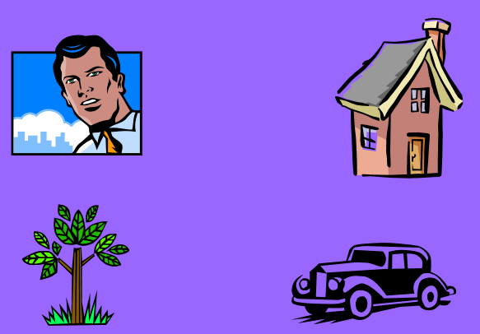
Another example:

Slide 23
Object-Orientation - Advantages
People think in terms of objects
OO models map to reality
Therefore, OO models are:
Easy to develop
Easy to understand

Slide 24
Principles of OOP
Abstraction: To have the relevant information.
Encapsulation: To hide information inside the object.
Polymorphism: To have many shapes / behaviors.
Inheritance: To create a new object with an existing one (To adopt features from others)

Slide 25
What is an Object?
An object:
Can be anything for which we want to save Information
Is something tangible (Person, Car)
Is something that can be captured intellectually (Time, Date)
An object has:
States / attributes / properties / data
Well-defined behavior / methods / functions
Unique identity

Slide 26
Technical Definition of an Object
“An Object is an Instance of a class”
“An Object is the implementation of a class”
Any tangible thing for which we want to save Information

Slide 27

Person as an Object
Attributes:
Name
Age
Behavior (operations)
Walks
Eats
Identity
Their name? (Can that be an identity?) – If not, then what should be?

Slide 28

Car as an Object
State (attributes)
Color
Model
Behavior (operations)
Accelerate
Start Car
Change Gear
Identity
Its registration number

Slide 29

Task: House as an Object?
Attributes?
Behavior?
Identity?

Slide 30

Task: Tree as an Object?
Attributes?
Behavior?
Identity?

Slide 31



Object Example: Airplane

Slide 32
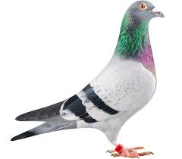
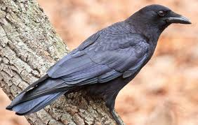
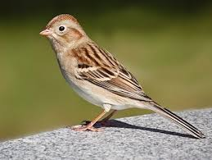
Object Example: Bird

Slide 33
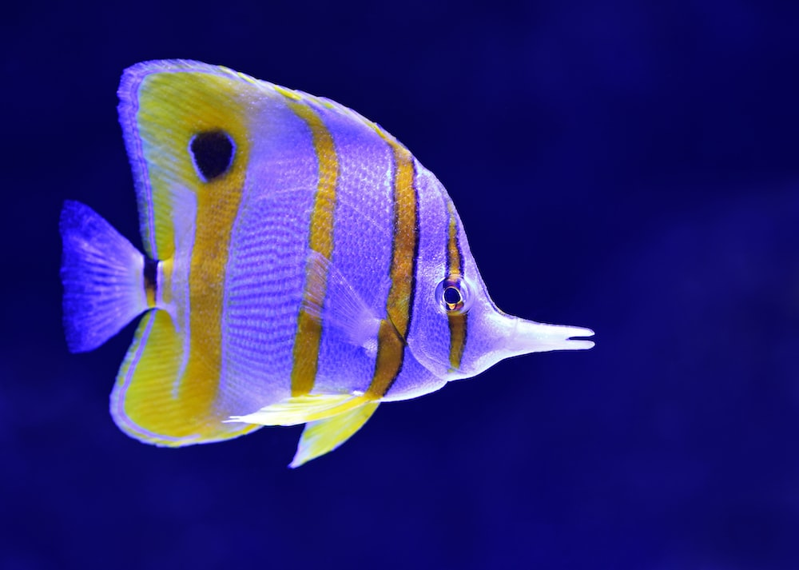


Object Example: Fish

Slide 34
You might have noticed…
Objects…
Belong to a group.
Have some similar nature.
Have some common attributes.
Have some common behaviors.
So, can we categorize objects based on some basic features …. ?

Slide 35
Activity
Think of other “classes” and their “objects” that we come across in real life

Slide 36
In short, we can say…
A class is:
A collection of similar objects.
The design of an object.
Details of an object.
Tells us what an object contains.

Slide 37
You might also see these terminologies…
A class :
It’s a blue print .
It’s a design or template.
An Object:
It’s an instance of a class.
Implementation of a class.
NOTE: Classes are invisible, object are visible

Slide 38
Fin.
: )

